Slide 1
2023-03-08

Slide 2
Unit 9 Project

Slide 3

Rogue
Rogue is a classic text-mode video game from the 80s. It spawned many similar games which are referred to as "Rogue-like." It ran on DOS systems (IBM PC), but also on Unix systems.

Slide 4
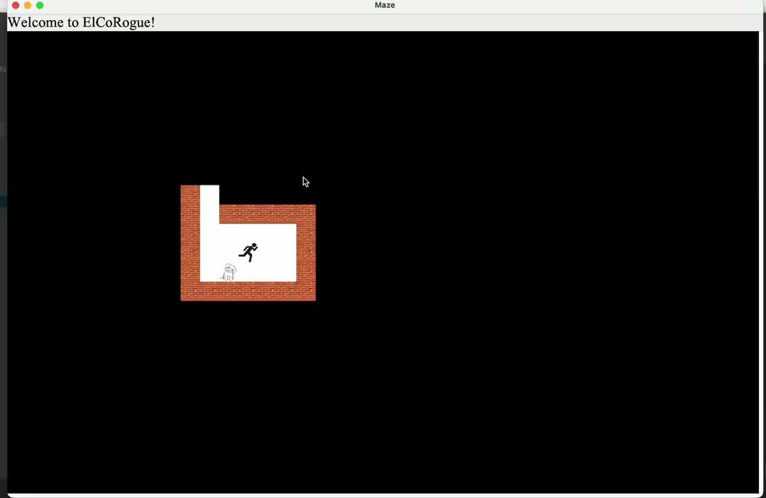
Maze Game
The Unit 9 Project is a Rogue-like maze game.
Out of the box, this is a working maze game. But you will write new subclasses to enhance it, and add your own personal stamp to it.

Slide 5
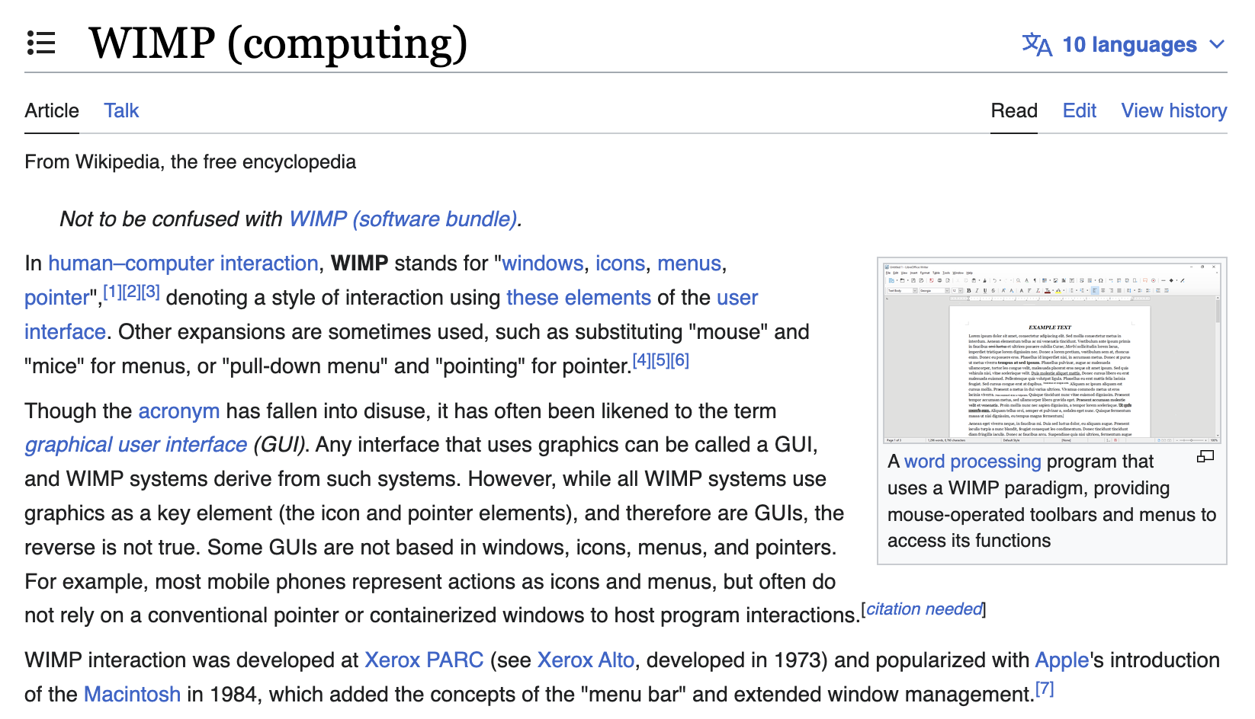

Slide 6
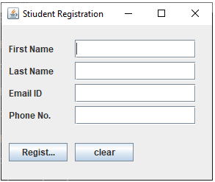
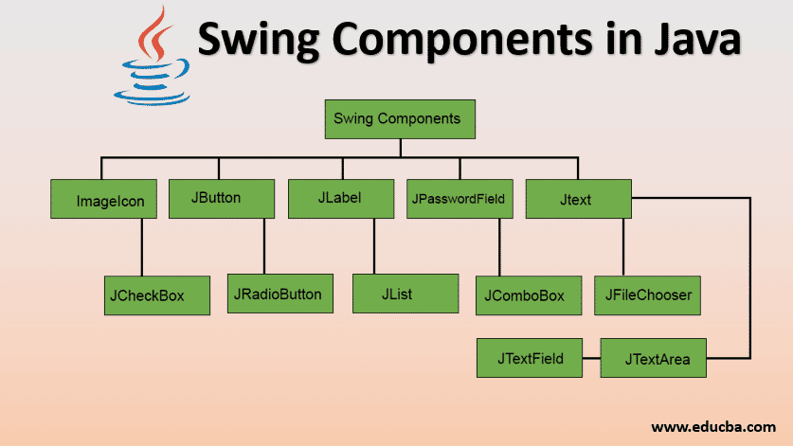
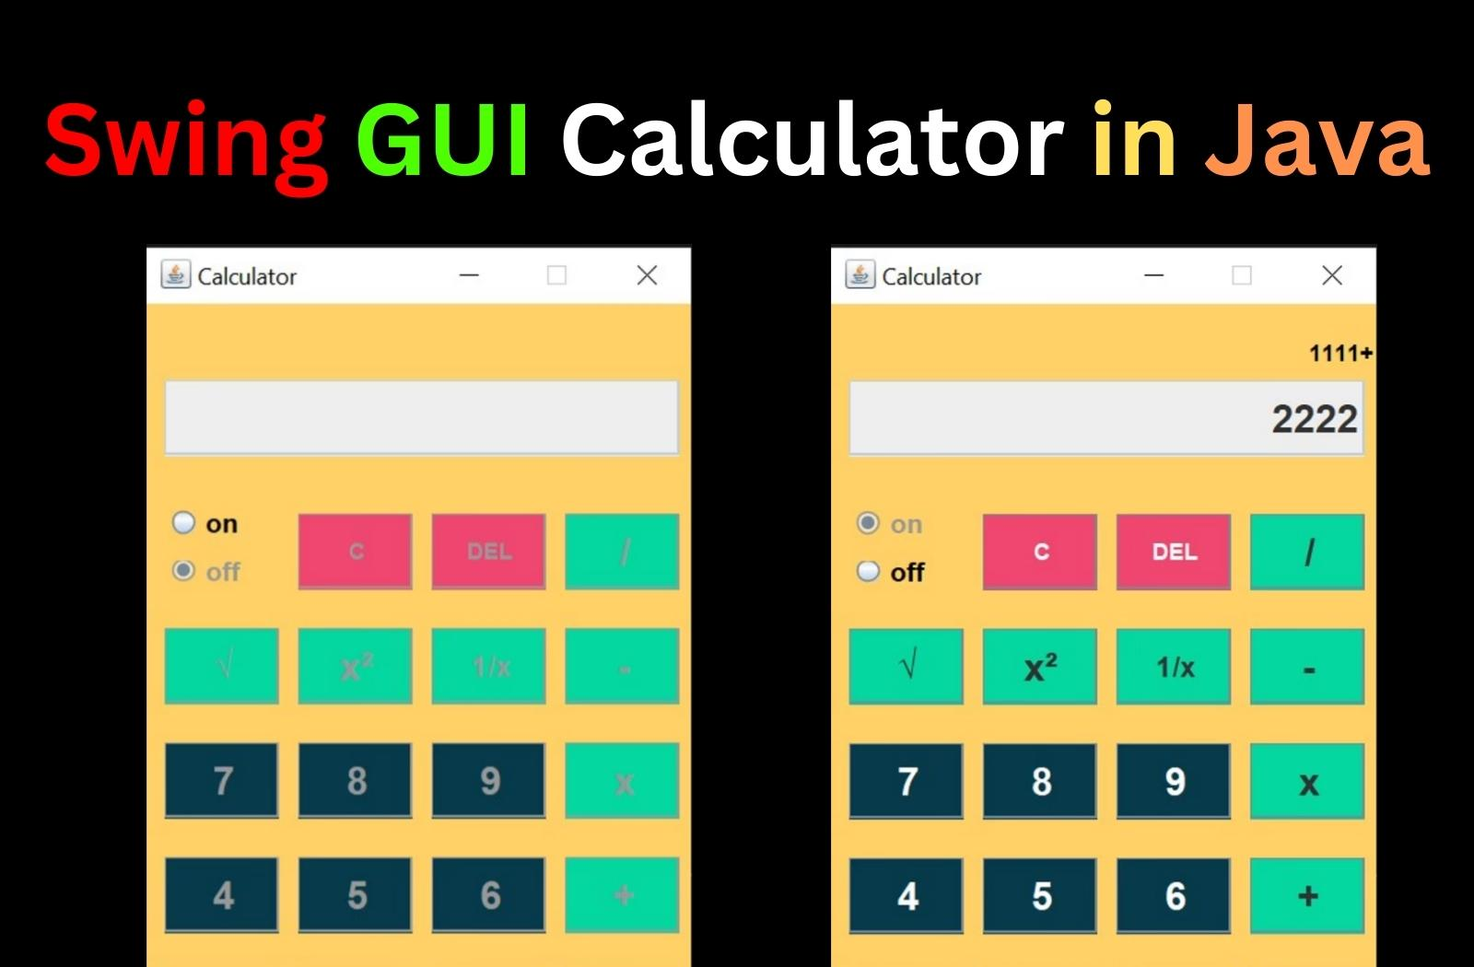
Student Registration

Slide 7
In the beginning, there was the command line...
Console / Command Line (CLI) Applications
Read from Standard Input (usually keyboard)
Write to Standard Output (usually a console window)
May have their own command loop
May be invoked from the OS command line
Pretty much what interacting with a computer was like until, say, the arrival of the original Mac in 1984
Still used every day by developers, but billions of people have probably never seen one
WIMP / GUI Applications
Often launched using an icon from the Windows/Mac/Linux OS desktop, which itself is a GUI application
Initialization creates a hierarchy of UI components (e.g., JFrame, JLabel, JPanel)
Main loop is an event loop, usually part of the GUI framework
Interaction with the user is handled through event objects: mouse clicks, key presses, text field changed, repeating timer fired
In Java Swing, classes register themselves as listeners for events.
The way most desktop and mobile apps are built

Slide 8

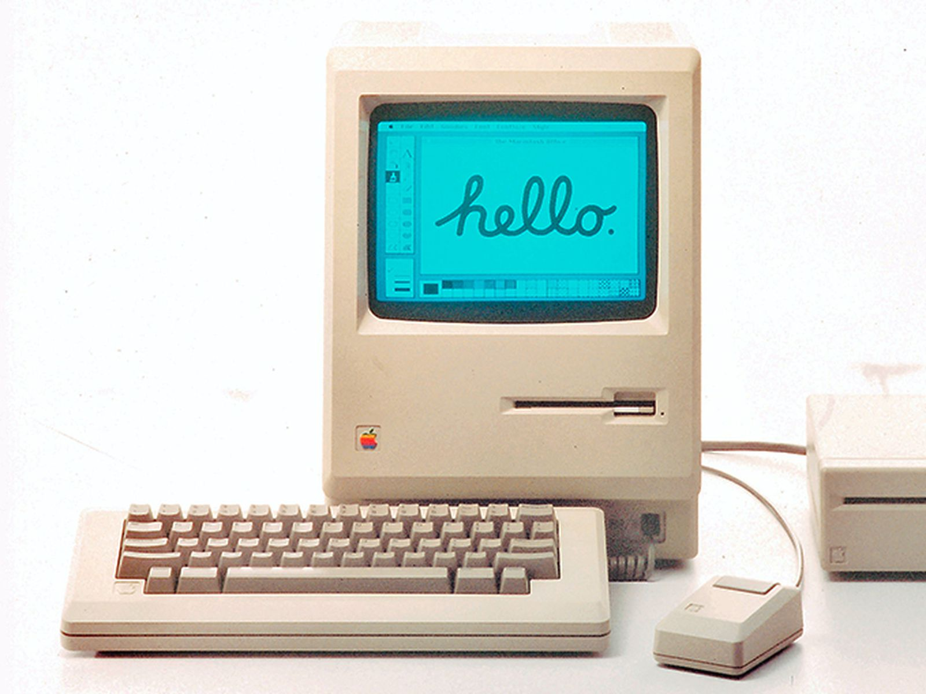

Slide 9
Rubric

Slide 10
#1 Make your own maze!
Edit the file maze.txt. You can make your own yourself, or you can use a maze generator such as https://www.dcode.fr/maze-generator
(If you use that maze generator, select Single Character display, not Square, for best results, and make sure you specify # as the wall character.)
Any size maze is supported, but don't make it too big because I have to play it!
15x15 or 20x20 is probably a decent size, although you can go smaller too.
Once you've generated or drawn a maze.txt, make sure you place the player, by putting a capital P somewhere. To place the little dog, put a lowercase d.
When editing maze.txt, you may find it helpful to press the INSERT key on the keyboard to enter Overwrite mode. (10 points)

Slide 11
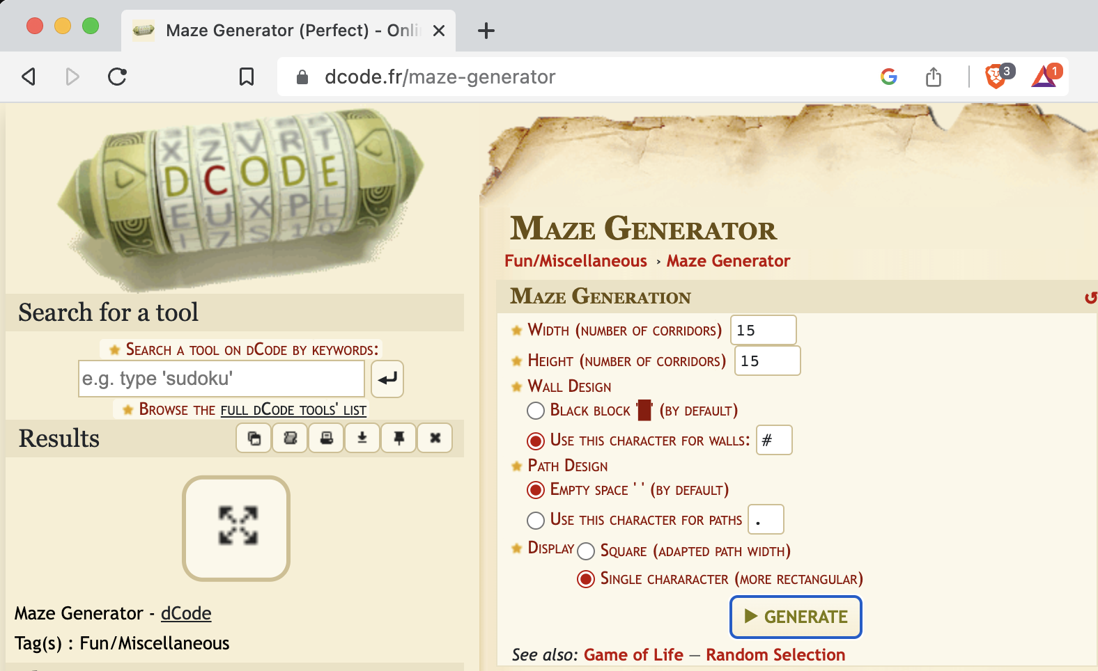

Slide 12
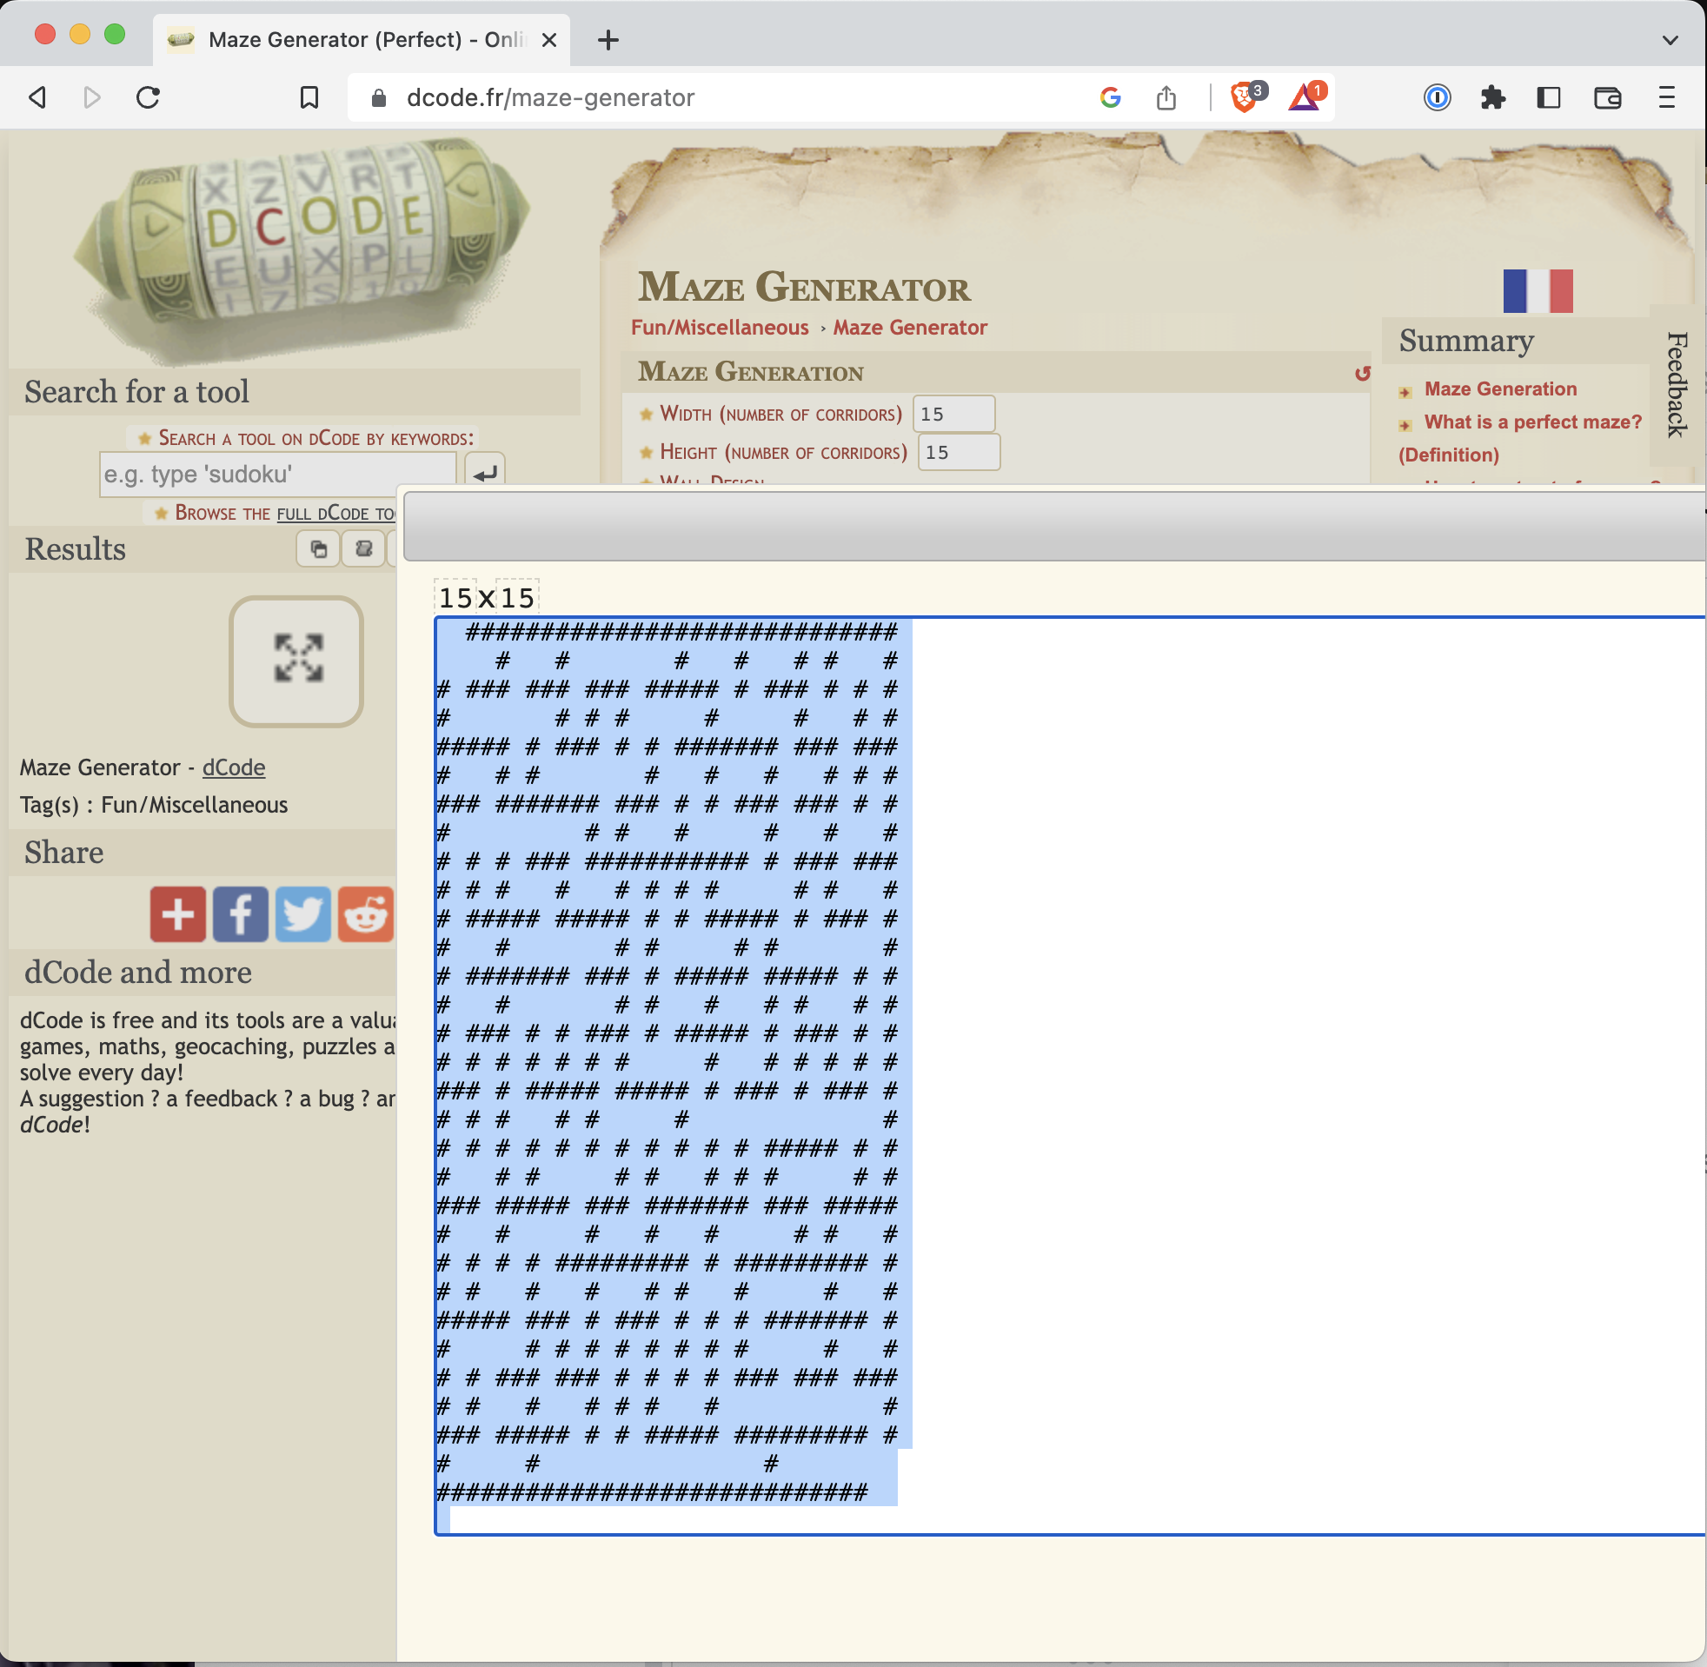

Slide 13
#2 "Re-skin" the maze graphics!
Replace the original images wall.jpg, player.png, etc. with images of your own choice. You can find images on the Internet, such as using the Image search option on Google.
If you like drawing, you could use an online drawing tool such as https://jspaint.app, or even draw with pen and paper and take a picture with a phone.
You will probably need to save the image file to the local computer and then use the Upload File button in replit.
Many image formats will work, but .jpg/.jpeg and .png are definitely supported.
IMPORTANT: Your images should be roughly square dimensions, and not be super high resolution. If the images are too high-resolution, the game will run slow. You can use a website like https://simpleimageresizer.com to reduce the size of your images. (10 points)

Slide 14
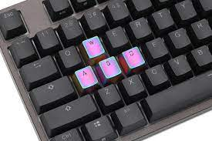
#3 Support alternative movement keys
Gamers often prefer using W (up), A (left), S (down), D (right) keys to the arrow keys for movement.
Look at the keyPressed method in Game.java and enhance it to support WASD as well as the arrow keys. The key codes for WASD start with VK_ for Virtual Key, e.g. VK_W, VK_A, VK_S, VK_D.
Another popular set of movement keys is H (left), J (down), K (up), and L (right)... you could choose to support those as well.
(10 points)

Slide 15
#4 Add a monster
Add a new MazeObject subclass which is a monster/creature of some kind that will chase the player.
Register it with the MazeObjectFactory. You will need to supply an image file, just like you did in Step 2.
Upload your image file to replit and override the getImagePath method in your subclass to return the filename of the image.
Add some instances of your creature subclass to maze.txt in different parts of your maze.
You can make multiple classes of creature if you want, but only one is required. (10 points)

Slide 16
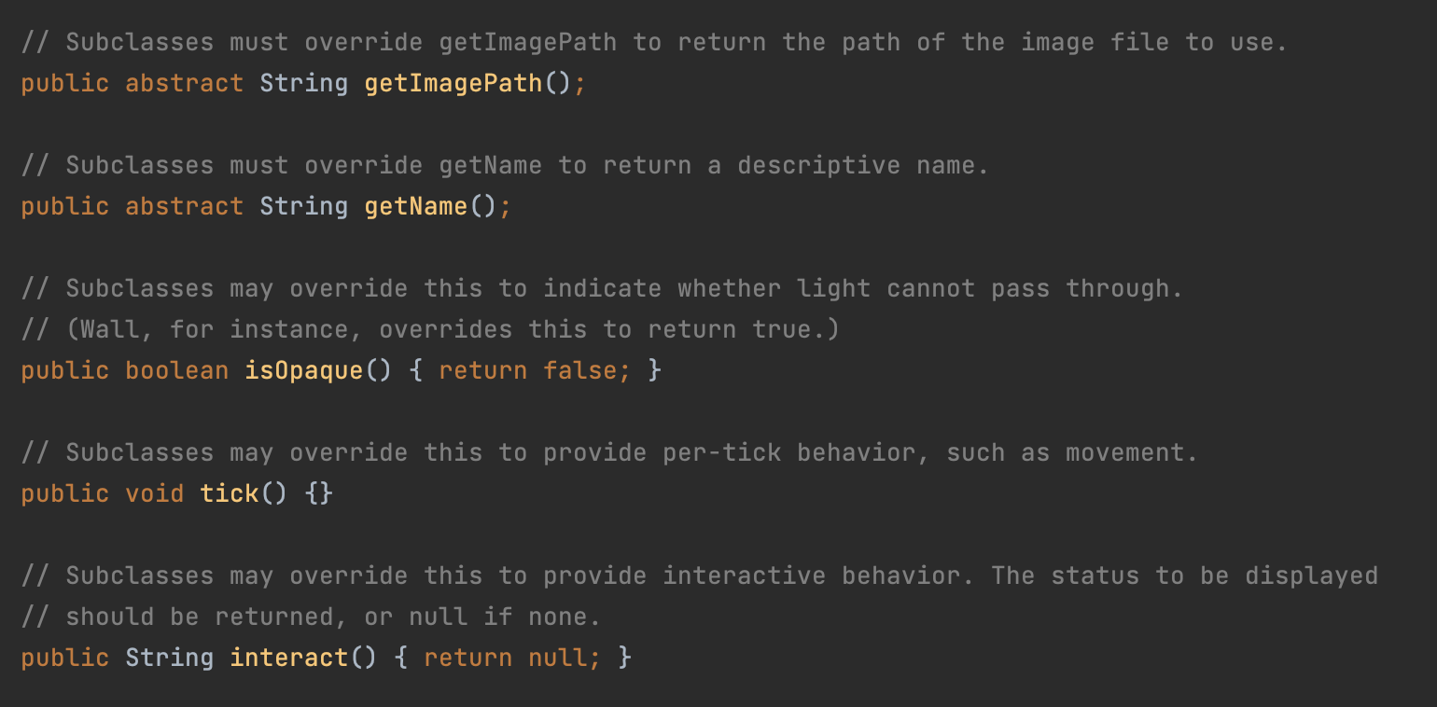
MazeObject.java - methods to override in subclasses

Slide 17
#5 Animate your monsters
Make the creatures move when the game invokes the "tick" method. look at the logic in Dog.java for inspiration. You will need to override the tick method in your monster subclass.
(10 points)

Slide 18
#6 Add an Item
The Item abstract class can be subclassed to put items in the game.
The way items behave in this game is that you pick them up by running over them.
The only item that comes out of the box is PieceOfTrash, which is trash spread around the maze which you can pick up as an (uncredited) good deed.
Add your own Item subclass which has more in-game significance, like a key to unlock the door out of the maze. You'll need to find another image file to represent the item, and upload it into the replit. Place your item(s) around the maze.
(10 points)

Slide 19
#7 Make a losing scenario
The game needs a way for the player to lose!
If the player bumps into one of the creatures or is bumped by it, the player should lose and the game should end.
The game can be ended by invoking the gameOver method of the Game object. (20 points)
(You can add a more elaborate combat scenario if you want, like a concept of player health and monster health and the ability to hit and be hit multiple times.)

Slide 20
#8 Make a winning scenario
The game needs a better way to win! Currently, the player wins the game by finding the exit of the maze and walking out.
Make it a little harder to win the game... but you can decide how you want the game to be won.
One idea is spread some items around the maze, and the user must collect all of them to unlock the way out.
Note how the Player class overrides the moveTo method and ends the game if the player moves off the map.
Change that to block them unless your winning criteria have been met.
(20 points)

